Slide 1

Computer Architecture and Operating Systems CS 3230: Operating System Section Lecture OS-6 Deadlocks
Department of Computer Science and Software Engineering
University of Wisconsin-Platteville

Slide 2
Outlines
Deadlock Problem
Deadlock Characterization
Resource Allocation Graph
Deadlock Handling Methods

Slide 3
Deadlock Problem
A set of blocked processes each holding a resource and waiting to acquire a resource held by another process in the set
Example
System has 2 tape drives
P₁ and P₂ each hold one tape drive and each needs another one
Example
semaphores A and B, initialized to 1
P₀ P₁
wait (A); wait(B)
wait (B); wait(A)

Slide 4
Deadlock Example
Traffic only in one direction
Each section of a bridge can be viewed as a resource
If a deadlock occurs, it can be resolved if one car backs up (preempt resources and rollback).
Several cars may have to be backed up if a deadlock occurs
Starvation is possible

Slide 5
Deadlock Characterization
Deadlock can arise if four conditions hold simultaneously
Mutual exclusion: only one process at a time can use a resource
Hold and wait: a process holding at least one resource is waiting to acquire additional resources held by other processes
No preemption: a resource can be released only voluntarily by the process holding it, after that process has completed its task
Circular wait: there exists a set {P₀, P₁, …, P₀} of waiting processes such that P₀ is waiting for a resource that is held by P₁, P₁ is waiting for a resource that is held by P₂, …, P_{n–1} is waiting for a resource that is held by P_{n}, and P_{n} is waiting for a resource that is held by P₀

Slide 6
System Model
Resource types R₁, R₂, . . ., R_{m}
CPU cycles, memory space, I/O devices
Each resource type R_{i} has W_{i} instances
Each process utilizes a resource as follows:
request
use
release

Slide 7
Resource Allocation Graph (RAG)
A set of vertices V and a set of edges E
V is partitioned into two types:
P = {P₁, P₂, …, P_{n}}, the set consisting of all the processes in the system
R = {R₁, R₂, …, R_{m}}, the set consisting of all resource types in the system
E is partitioned into two types:
request edge – directed edge P_{i} → R_{j}
assignment edge – directed edge R_{j} → P_{i}

Slide 8
RAG Components
Process
Resource Type with 4 instances
P_{i} requests instance of R_{j}
P_{i} is holding an instance of R_{j}
P_{i}
R_{j}
P_{i}
R_{j}

Slide 9
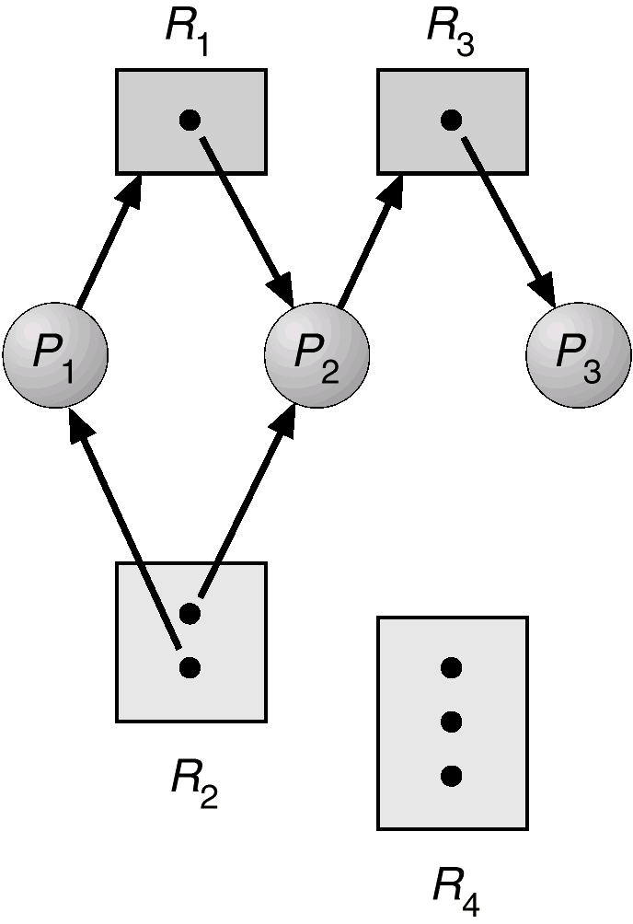
RAG Example 1

Slide 10
RAG Facts
If graph contains no cycles ⇒ no deadlock
If graph contains a cycle ⇒
if only one instance per resource type, then deadlock
if several instances per resource type, possibility of deadlock

Slide 11
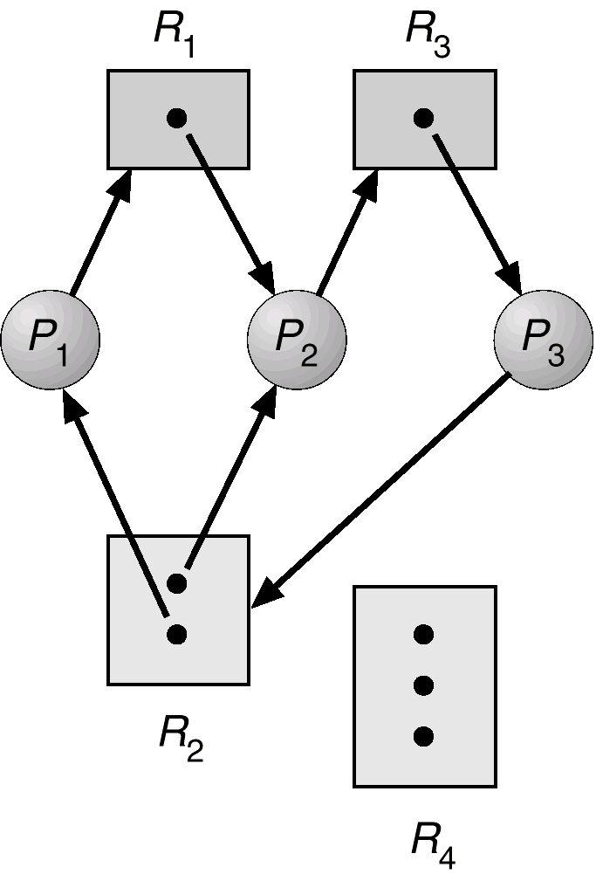
RAG Example 2
Graph shows a deadlock case
Why?

Slide 12
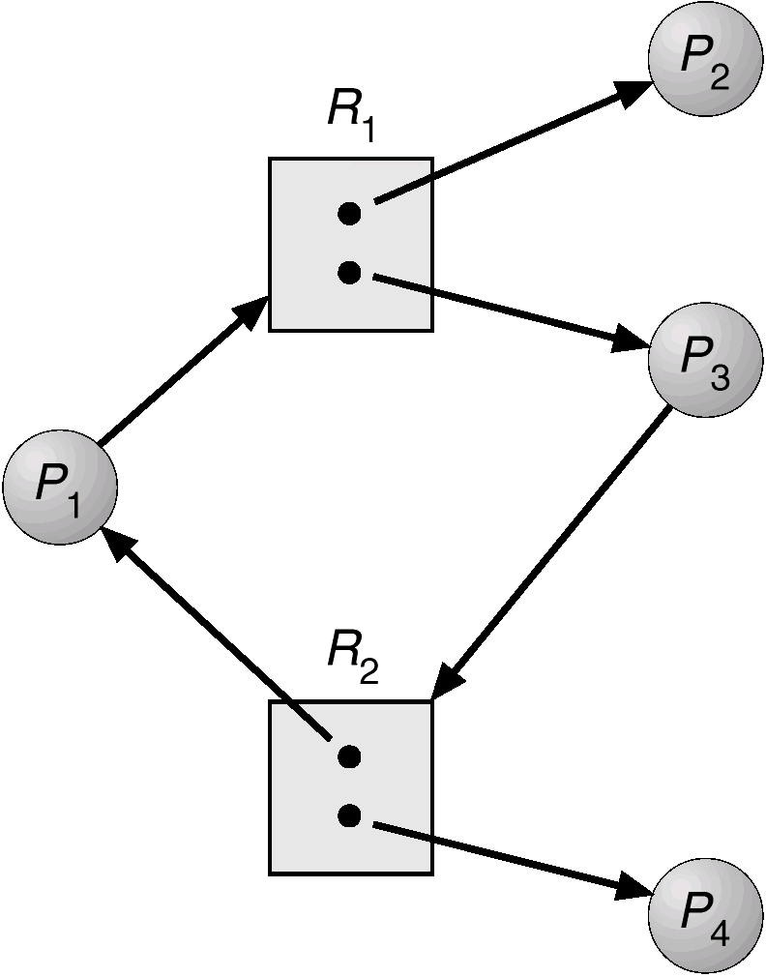
RAG Example 3
Graph contains a cycle
But, no deadlock

Slide 13
Handling Deadlock
Handling methods
Ensure that the system will never enter a deadlock state (deadlock prevention or avoidance)
Allow the system to enter a deadlock state and then recover (deadlock detection)
Ignore the problem and pretend that deadlocks never occur in the system; used by most operating systems, including UNIX

Slide 14
Deadlock Prevention
Restrain the ways request can be made
Mutual Exclusion – required for sharable resources; not required for non-sharable resources
Hold and Wait – must guarantee that whenever a process requests a resource, it does not hold any other resources
Approaches:
Require process to request and be allocated all its resources before it begins execution
allow process to request resources only when the process has none
Problem:
Low resource utilization
starvation possible

Slide 15
Deadlock Prevention
No Preemption
If a process that is holding some resources requests another resource that cannot be immediately allocated to it, then
all resources currently being held are released
Preempted resources are added to the list of resources for which the process is waiting
Process will be restarted only when it can regain its old resources, as well as the new ones that it is requesting
Circular Wait
Impose a total ordering of all resource types, and require that each process requests resources in an increasing order of enumeration

Slide 16
Deadlock Avoidance
Requires that the system has some additional a priori information available
Each process declare the maximum number of resources of each type that it may need
The deadlock-avoidance algorithm dynamically examines the resource-allocation state to ensure that there can never be a circular-wait condition
Resource-allocation state is defined by
the number of available and allocated resources, and the maximum demands of the processes

Slide 17
Safe State
When a process requests an available resource, system must decide if immediate allocation leaves the system in a safe state
System is in safe state if there exists a safe sequence of all processes
Sequence <P₁, P₂, …, P_{n}> is safe if for each P_{i}, the resources that Pi can still request can be satisfied by currently available resources + resources held by all the P_{j}, with j<I
If P_{i} resource needs are not immediately available, then P_{i} can wait until all P_{j} have finished
When P_{j} is finished, P_{i} can obtain needed resources, execute, return allocated resources, and terminate
When P_{i} terminates, P_{i+1} can obtain its needed resources, and so on
The safe sequence is not necessarily unique

Slide 18
Safe State: Facts
If a system is in safe state ⇒ no deadlocks
If a system is in unsafe state ⇒ possibility of deadlock
Avoidance ⇒ ensure that a system will never enter an unsafe state

Slide 19
Deadlock Avoidance: RAG Algorithm
Claim edge P_{i} → R_{j} indicated that process P_{j} may request resource R_{j}; represented by a dashed line
Claim edge converts to request edge when a process requests a resource
When a resource is released by a process, assignment edge reconverts to a claim edge
Resources must be claimed a priori in the system

Slide 20
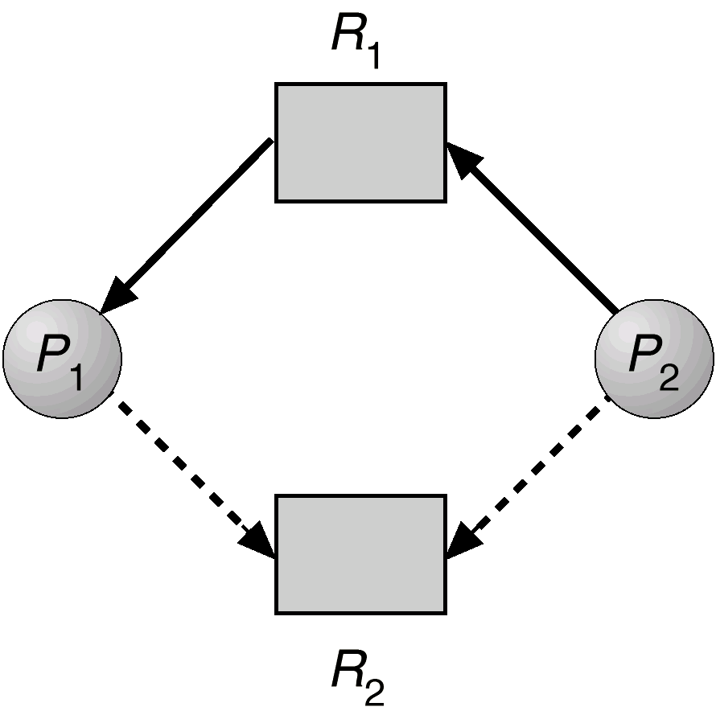
RAG Algorithm

Slide 21
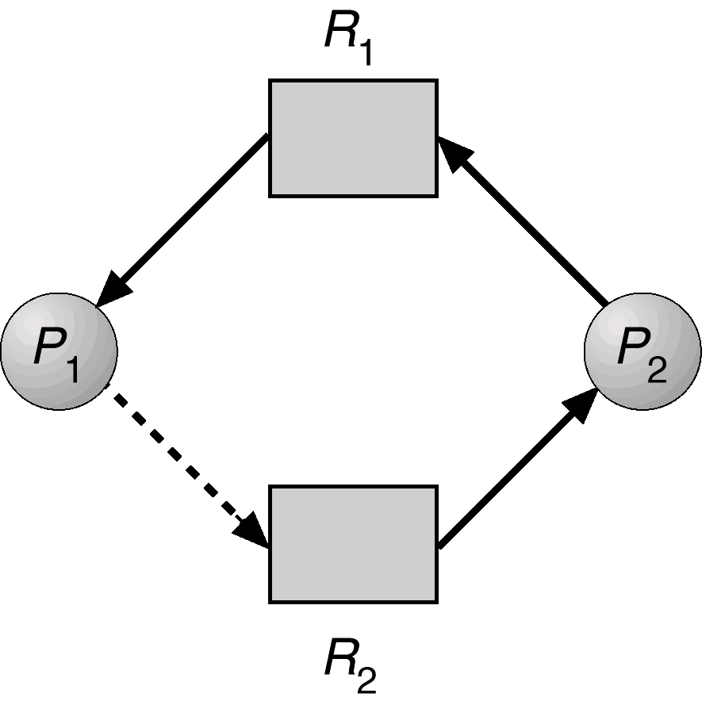
RAG Algorithm: Unsafe State

Slide 22
Banker’s Algorithm
Multiple instances
Each process must a priori claim maximum use
When a process requests a resource it may have to wait
When a process gets all its resources it must return them in a finite amount of time
Notes:
https://www.youtube.com/watch?v=w0LwGqffUkg&noredirect=1

Slide 23
Banker’s Algorithm: Data structure
Let n = number of processes, and m = number of resources types
Available: Vector of length m.
If available [j] = k, there are k instances of resource type R_{j} available
Max: n x m matrix
If Max [i,j] = k, then process P_{i} may request at most k instances of resource type R_{j}.
Allocation: n x m matrix
If Allocation[i,j] = k then P_{i} is currently allocated k instances of R_{j.}
Need: n x m matrix
If Need[i,j] = k, then P_{i} may need k more instances of R_{j} to complete its task
Need [i,j] = Max[i,j] – Allocation [i,j]
Notes:
https://www.youtube.com/watch?v=w0LwGqffUkg&noredirect=1

Slide 24
Banker’s Algorithm: Example
5 processes P₀ through P₄; 3 resource types A (10 instances), B (5 instances), and C (7 instances)
Snapshot at time T₀:
Allocation Max Available
A B C A B C A B C
P₀ 0 1 0 7 5 3 3 3 2
P₁ 2 0 0 3 2 2
P₂ 3 0 2 9 0 2
P₃ 2 1 1 2 2 2
P₄ 0 0 2 4 3 3
Notes:
https://www.youtube.com/watch?v=w0LwGqffUkg&noredirect=1

Slide 25
Banker’s Algorithm: Example
Need is defined to be Max – Allocation
Snapshot at time T₀ :
Need
A B C
P₀ 7 4 3
P₁ 1 2 2
P₂ 6 0 0
P₃ 0 1 1
P₄ 4 3 1
Notes:
https://www.youtube.com/watch?v=w0LwGqffUkg&noredirect=1

Slide 26
Safety Algorithm
1. Let Work and Finish be vectors of length m and n, respectively. Initialize:
Work := Available
Finish [i] = false for i - 1,3, …, n
2. Find i such that both:
(a) Finish [i] = false
(b) Need_{i} ≤ Work
If no such i exists, go to step 4.
3. Work := Work + Allocation_{i} Finish[i] := true go to step 2
4. If Finish [i] = true for all i, then the system is in a safe state
Notes:
https://www.youtube.com/watch?v=w0LwGqffUkg&noredirect=1

Slide 27
Resource-Request Algorithm for Process P_{i}
Request_{i} = request vector for process P_{i}. If Request_{i} [j] = k then process P_{i} wants k instances of resource type R_{j}
1. If Request_{i} ≤ Need_{i} go to step 2. Otherwise, raise error condition, since process has exceeded its maximum claim
2. If Request_{i} ≤ Available, go to step 3. Otherwise P_{i} must wait, since resources are not available
3. Pretend to allocate requested resources to P_{i} by modifying the state as follows:
Available := Available – Request_{i} ;
Allocation_{i} := Allocation_{i} + Request_{i} ;
Need_{i} := Need_{i} – Request_{i ;}
If safe ⇒ the resources are allocated to P_{i}.
If unsafe ⇒ P_{i} must wait, and the old resource-allocation state is restored
Notes:
https://www.youtube.com/watch?v=w0LwGqffUkg&noredirect=1

Slide 28
Banker’s Algorithm: Example
5 processes P₀ through P₄; 3 resource types A (10 instances), B (5instances, and C (7 instances)
Snapshot at time T₀:
Allocation Max Available
A B C A B C A B C
P₀ 0 1 0 7 5 3 3 3 2
P₁ 2 0 0 3 2 2
P₂ 3 0 2 9 0 2
P₃ 2 1 1 2 2 2
P₄ 0 0 2 4 3 3
Notes:
https://www.youtube.com/watch?v=w0LwGqffUkg&noredirect=1

Slide 29
Banker’s Algorithm: Example
Need is defined to be Max – Allocation
Need
A B C
P₀ 7 4 3
P₁ 1 2 2
P₂ 6 0 0
P₃ 0 1 1
P₄ 4 3 1
The system is in a safe state since the sequence < P₁, P₃, P₄, P₂, P₀> satisfies safety criteria
Notes:
https://www.youtube.com/watch?v=w0LwGqffUkg&noredirect=1

Slide 30
Banker’s Algorithm: Example
P₁ request (1,0,2)
Check that Request ≤ Available (that is, (1,0,2) ≤ (3,3,2) ⇒ true.
Allocation Need Available
A B C A B C A B C
P₀ 0 1 0 7 4 3 2 3 0
P₁ 3 0 2 0 2 0
P₂ 3 0 1 6 0 0
P₃ 2 1 1 0 1 1
P₄ 0 0 2 4 3 1
Executing safety algorithm shows that sequence <P₁, P₃, P₄, P₀, P₂> satisfies safety requirement.
Can request for (3,3,0) by P₄ be granted?
Can request for (0,2,0) by P₀ be granted?
Notes:
https://www.youtube.com/watch?v=w0LwGqffUkg&noredirect=1
P4 request will be unsafe (deadlock)
P0 request will be unsafe (deadlock)
- Both requests will be denied

Slide 31
Deadlock Detection
Allow system to enter deadlock state
Detection algorithm
Recovery scheme

Slide 32
Case 1: Single Instance of Each Resource Type
Maintain wait-for graph
Nodes are processes.
P_{i} → P_{j} if P_{i} is waiting for P_{j}.
Periodically invoke an algorithm that searches for acycle in the graph.
An algorithm to detect a cycle in a graph requires an order of n² operations, where n is the number of vertices in the graph

Slide 33
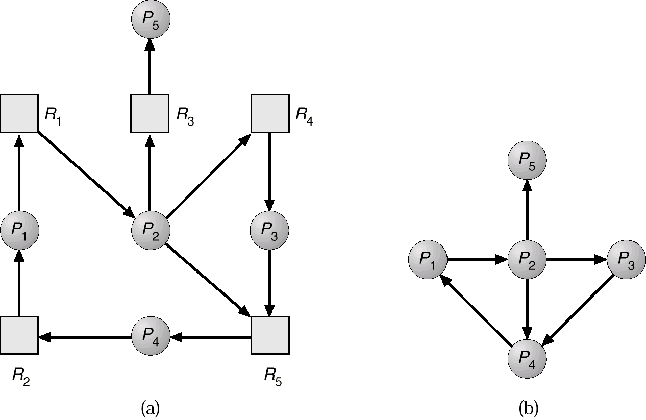
RAG and Wait-for Graph

Slide 34
Case 2: Several Instances of Each Resource Type
Available:
A vector of length m indicates the number of available resources of each type
Allocation:
An n x m matrix defines the number of resources of each type currently allocated to each process
Request:
An n x m matrix indicates the current request of each process.
If Request [ij] = k, then process P_{i} is requesting k more instances of resource type. R_{j}

Slide 35
Detection Algorithm
Let Work and Finish be vectors of length m and n, respectively Initialize:
(a) Work :- Available
(b) For i = 1,2, …, n, if Allocation_{i} ≠ 0, then Finish[i] := false;otherwise, Finish[i] := true.
Find an index i such that both:
(a) Finish[i] = false
(b) Request_{i} ≤ Work
If no such i exists, go to step 4
Work := Work + Allocation_{i} Finish[i] := true go to step 2
If Finish[i] = false, for some i, 1 ≤ i ≤ n, then the system is in deadlock state. Moreover, if Finish[i] = false, then P_{i} is deadlocked

Slide 36
Detection Algorithm Example
Five processes P₀ through P₄; three resource types: A (7 instances), B (2 instances), and C (6 instances).
Snapshot at time T₀:
Allocation Request Available
A B C A B C A B C
P₀ 0 1 0 0 0 0 0 0 0
P₁ 2 0 0 2 0 2
P₂ 3 0 3 0 0 0
P₃ 2 1 1 1 0 0
P₄ 0 0 2 0 0 2
Sequence <P₀, P₂, P₃, P₁, P₄> will result in Finish[i] = true for all i.

Slide 37
Detection Algorithm Example
P₂ requests an additional instance of type C Request
A B C
P₀ 0 0 0
P₁ 2 0 1
P₂ 0 0 1
P₃ 1 0 0
P₄ 0 0 2
State of system?
Can reclaim resources held by process P₀, but insufficient resources to fulfill other processes; requests.
Deadlock exists, consisting of processes P₁, P₂, P₃, and P₄.

Slide 38
Detection Algorithm Usage
When, and how often, to invoke depends on:
How often a deadlock is likely to occur?
How many processes will need to be rolled back?
one for each disjoint cycle
If detection algorithm is invoked arbitrarily, there may be many cycles in the resource graph and so we would not be able to tell which of the many deadlocked processes “caused” the deadlock

Slide 39
Deadlock Recovery
Process Termination
Abort all deadlocked processes
Abort one process at a time until the deadlock cycle is eliminated
In which order should we choose to abort?
Priority of the process
How long process has computed, and how much longer to completion
Resources the process has used
Resources process needs to complete
How many processes will need to be terminated
Is process interactive or batch?

Slide 40
Deadlock Recovery
Resource Preemption
Selecting a victim – minimize cost
Rollback – return to some safe state, restart process fro that state
Starvation – same process may always be picked as victim, include number of rollback in cost factor

Slide 41
Combined Approach to Deadlock Handling
Combine the three basic approaches
prevention
avoidance
Detection
allowing the use of the optimal approach for each of resources in the system
Partition resources into hierarchically ordered classes.
Use most appropriate technique for handling deadlocks within each class

